Slide 1

SOWIT Video Resource Kit
(Part 1)
Developed by English Language Education Section
Curriculum Development Institute
Education Bureau

Slide 2
Background
The SOWIT Video Series…
  has been launched in January 2021 in support of the cross-curricular campaign “Promoting Positive Values and Attitudes through English Sayings of Wisdom (SOW)”
  integrates live-action, animation and motion graphics to illustrate selected SOW in a vibrant and entertaining manner
The SOWIT Video Resource Kit…
  synergises the use of the SOWIT videos in the learning and teaching of SOW and promoting positive values and attitudes in the English lessons

Slide 3
Aims of the Resource Kit
To complement the SOWIT videos by providing suggestions on how to effectively use the videos to enrich students’ English learning experiences and create an inspiring and engaging environment for the learning and teaching of SOW
To enhance students’ viewing and multimodal literacy skills through appreciation of the SOWIT videos
To reinforce the development of positive values and attitudes through appreciating and reflecting on the stories presented in the SOWIT videos

Slide 4
Content of the Resource Kit
Ten sets of learning and teaching materials for the first batch of SOWIT video series:
  suggested for use in the upper primary and junior secondary English classrooms, with adaptations as appropriate to cater for the diverse learning needs, interests and abilities of students
  comprising teaching plans, including pre-viewing, viewing and post-viewing activities, and covering understanding of story elements (e.g. characterisation, setting, plot development) and appreciation of features of multimodal literacy (e.g. images, music, sound effects)
  cultivating positive values and attitudes through inspiring students to reflect on the stories presented in the videos

Slide 5

Lesson Plan 1
Through appreciating a story about a farmer who learnt to cherish what he had, students are guided to
  learn about the saying “Count your blessings”
  understand the related positive values and attitudes (e.g. be grateful, cherish what we have, be positive)
  write a reflection on their personal experience

Slide 6

Lesson Plan 2
Through appreciating a story about how gratitude leads to a contented life, students are guided to
  understand the meaning of the saying “Gratitude turns what we have into enough”
  learn about the related positive values and attitudes (e.g. be grateful, cherish what we have, be positive)
  write a note to express gratitude to the person(s) they appreciate

Slide 7

Lesson Plan 3
Through watching a video about a turtle getting a favour in return for his good deed, students are guided to
  understand the meaning of the saying “One good turn deserves another”
  learn about the related positive values and attitudes (e.g. be grateful, cherish what we have, be positive, be optimistic)
  write a short “Thank-you” note and/or a reflection to show their appreciation for someone’s kindness

Slide 8
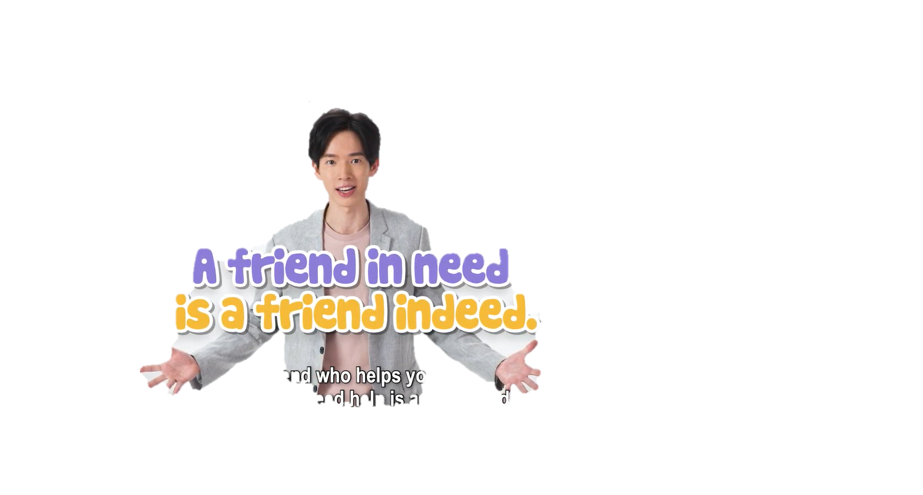
Lesson Plan 4
Through watching a video about Mr Fox who learnt to identify and show appreciation to his true friends, students are guided to
  understand the meaning of the saying “A friend in need is a friend indeed”
  learn about the related positive values and attitudes (e.g. care for others, empathy)
  write an email to a friend to give advice on friendship

Slide 9

Lesson Plan 5
Through watching a video about a young man’s homesickness when studying abroad, students are guided to
  understand the meaning of the saying “Home is where the heart is”
  learn about the related positive values and attitudes (e.g. be grateful, cherish what we have)
  write a recount of an incident that shows how important their home and
  family is to them

Slide 10

Lesson Plan 6
Through watching a video about the importance of seeing things from different perspectives and cherishing the things we have, students are guided to
  understand the meaning of the saying “The grass is always greener on the other side of the fence”
  learn about the related positive values and attitudes (e.g. be grateful, be positive, cherish what we have)
  brainstorm ideas and design a poster to promote the message of “Staying Positive”

Slide 11

Lesson Plan 7
Through appreciating a story about how the presenter helped stop a fire from happening, students are guided to
  understand the meaning of the saying “Prevention is better than cure”
  learn about the related positive values and attitudes (e.g. be proactive, be positive, cherish what we have)
  write a reflection on their personal experience

Slide 12

Lesson Plan 8
Through watching a video about two scientists competing to be the first to land on the moon, students are guided to
  understand the meaning of the saying “The early bird catches the worm”
  learn about the related positive values and attitudes (e.g. be proactive, be perseverant, be optimistic, be diligent)
  write an email giving advice on how to achieve success

Slide 13

Lesson Plan 9
Through appreciating a story about a vendor who experienced ups and downs when selling his snacks in the street, students are guided to
  understand the meaning of the saying “Every dog has its day”
  learn about the related positive values and attitudes (e.g. be perseverant, be positive)
  prepare a collection of proverbs which convey the message of perseverance and staying positive

Slide 14

Lesson Plan 10
Through watching a video about how a man and his descendants worked with determination and eventually succeeded in digging a tunnel through a mountain, students are guided to
  understand the meaning of the saying “Where there’s a will, there’s a way”
  learn about the related positive values and attitudes (e.g. cherish what we have, be positive, be optimistic)
  write a short description about their dream job and how they can achieve their goals

Slide 15
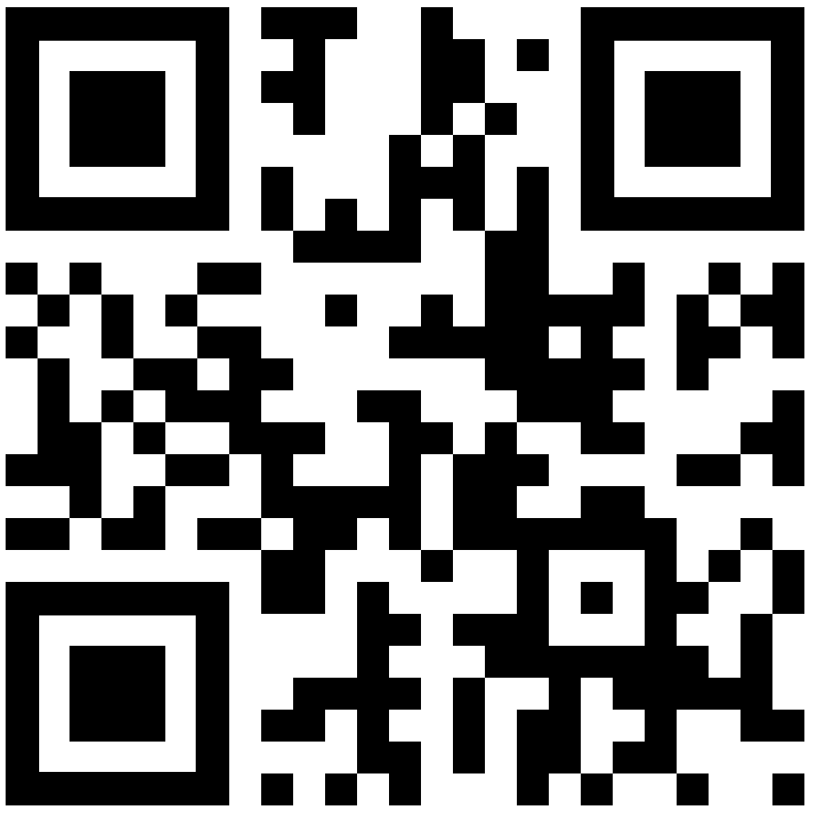
Using the SOWIT Video
Resource Kit in the English Lessons
Tying in with the modules and topics in the school-based English Language curriculum, schools are encouraged to make use of the lesson plans in the resource kit to enrich students’ English learning experiences and create an inspiring and engaging environment for the learning and teaching of SOW in the English lessons.
Teachers are encouraged to select and adapt the materials to suit their students’ needs, interests and abilities.
Posters, games, learning and teaching materials and SOWIT videos are available on the website of the Education Bureau (http://www.edb.gov.hk/sow).

